Slide 1


Artificial language learning workshop: Lecture 1
James Brand
j.brand@lancaster.ac.uk

Slide 2
Overview
Artificial Language Learning
Outline
What you will learn today:
What Artificial Language Learning is
Why it is used in linguists research
How it is used in linguistics research
The benefits of using the paradigm
The validity of the paradigm

Slide 3
Overview
Artificial Language Learning
Outline
What you will learn in lecture 2:
Research that uses ALL to investigate grammar learning
Research that uses ALL to investigate word learning
Research that uses ALL to investigate language evolution

Slide 4
Overview
Artificial Language Learning
Outline
What you will learn in lectures 3 and 4:
What it is like to take part in an ALL experiment
How to design an ALL experiment
How to program an ALL experiment in PsychoPy
How to interpret the data
Ways to design your own ALL experiment

Slide 5
Overview
Experimental diachronics
What is language evolution?
Darwin (1837)

Slide 6
Overview
Experimental diachronics
What is language evolution?
Schleicher (1863)

Slide 7
Overview
Experimental diachronics
What is language evolution?
Gray et al., 2010

Slide 8
Motivations
Experimental diachronics
Why study language evolution?
http://www.nytimes.com/2007/11/01/science/01chimp.html
Notes:
Human unique language – no other communication system in animals

Slide 9
Motivations
Experimental diachronics
Why study language evolution?
Rise of the Planet of the Apes (2011)

Slide 10
Motivations
Experimental diachronics
Why study language evolution?
haha
lol
aaaaaa
*grunt*
$%£#

Slide 11
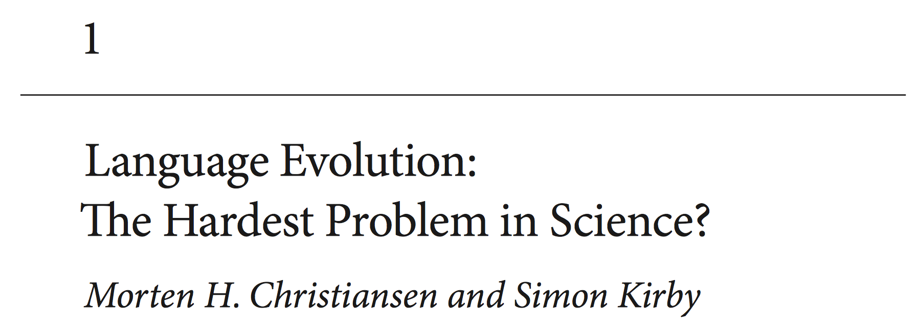
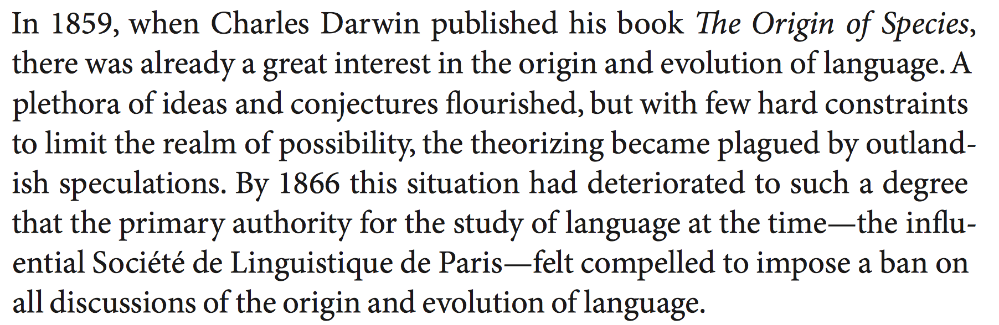
Motivations
Experimental diachronics
Why study language evolution?
Christiansen & Kirby (2003)

Slide 12
Methods
Experimental diachronics
How to study language evolution
https://startlediguana.files.wordpress.com/2013/10/boule_skulls.gif

Slide 13
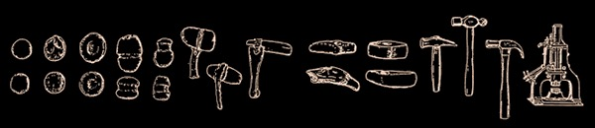
Methods
Experimental diachronics
How to study language evolution
Basalla (1988)

Slide 14
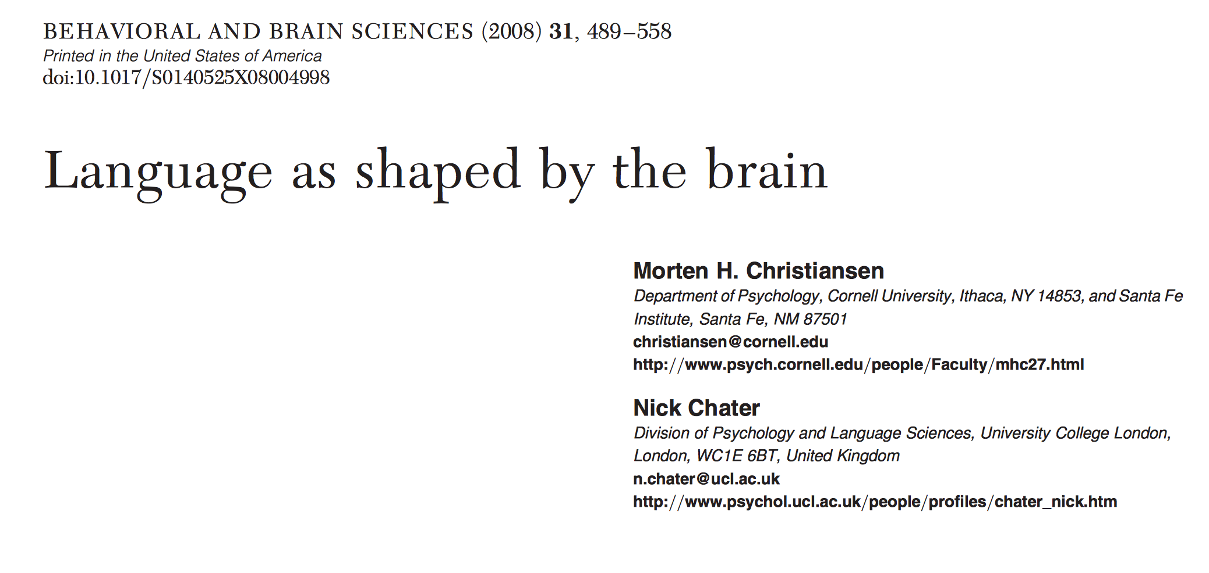
Methods
Experimental diachronics
How to study language evolution
Christiansen & Chater (2008)
Notes:
Evolution of cognition – leads to learning biases Learning biases shape culture

Slide 15
Methods
Experimental diachronics
How to study language evolution
Notes:
Evolution of cognition – leads to learning biases Learning biases shape culture

Slide 16
Methods
Experimental diachronics
How to study language evolution
1 8 5 0 3 7 6 2 4 9
Notes:
Evolution of cognition – leads to learning biases Learning biases shape culture

Slide 17
Methods
Experimental diachronics
How to study language evolution
Notes:
Evolution of cognition – leads to learning biases Learning biases shape culture

Slide 18
Methods
Experimental diachronics
How to study language evolution
0 1 2 3 4 5 6 7 8 9
Notes:
Evolution of cognition – leads to learning biases Learning biases shape culture

Slide 19
Methods
Experimental diachronics
How to study language evolution
Notes:
Evolution of cognition – leads to learning biases Learning biases shape culture

Slide 20
Methods
Experimental diachronics
How to study language evolution
icuetfsogrisoslimsncmhlou
Notes:
Evolution of cognition – leads to learning biases Learning biases shape culture

Slide 21
Methods
Experimental diachronics
How to study language evolution
Notes:
Evolution of cognition – leads to learning biases Learning biases shape culture

Slide 22
Methods
Experimental diachronics
How to study language evolution
summerschooloflinguistics
Notes:
Evolution of cognition – leads to learning biases Learning biases shape culture

Slide 23
Methods
Experimental diachronics
How to study language evolution
Notes:
Evolution of cognition – leads to learning biases Learning biases shape culture

Slide 24
Methods
Experimental diachronics
How to study language evolution
http://www.replicatedtypo.com/iterated-learning-using-youtube-videos/6093.html
Notes:
Evolution of cognition – leads to learning biases Learning biases shape culture

Slide 25
Methods
Experimental diachronics
How to study language evolution
Arrival (2016)
Notes:
Evolution of cognition – leads to learning biases Learning biases shape culture

Slide 26



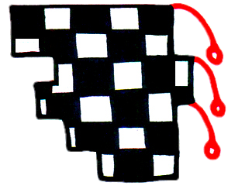
Methods
Experimental diachronics
How to study language evolution
gahemi
hekipo
kilonu
lenoga
Brand & Monaghan (in prep)
Notes:
Evolution of cognition – leads to learning biases Learning biases shape culture

Slide 27
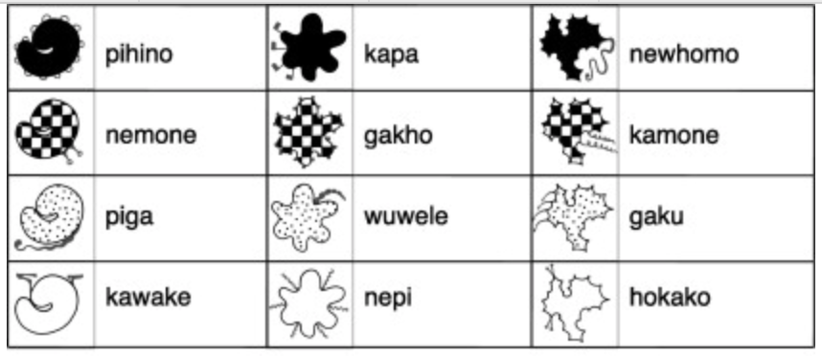
Methods
Experimental diachronics
How to study language evolution
Generation 1
Kirby, Tamariz, Cornish & Smith (2015)
Notes:
Evolution of cognition – leads to learning biases Learning biases shape culture

Slide 28
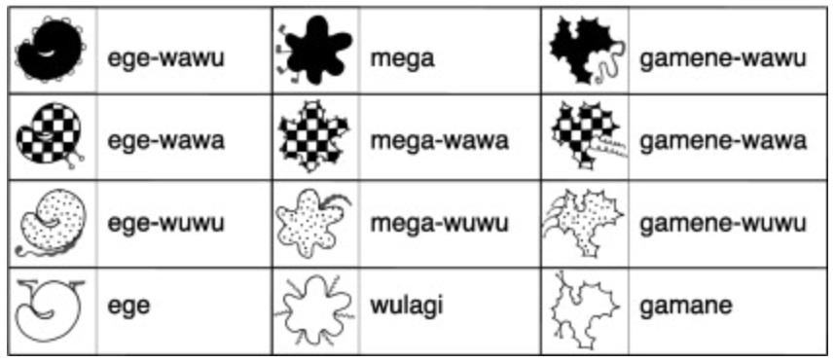
Methods
Experimental diachronics
How to study language evolution
Generation 10
Kirby, Tamariz, Cornish & Smith (2015)
Notes:
Evolution of cognition – leads to learning biases Learning biases shape culture

Slide 29
Methods
Experimental diachronics
How to study language evolution
Fehér et al (2017)
Notes:
Evolution of cognition – leads to learning biases Learning biases shape culture

Slide 30
Methods
Experimental diachronics
How to study language evolution
Claidière et al (2014)
Notes:
Evolution of cognition – leads to learning biases Learning biases shape culture

Slide 31
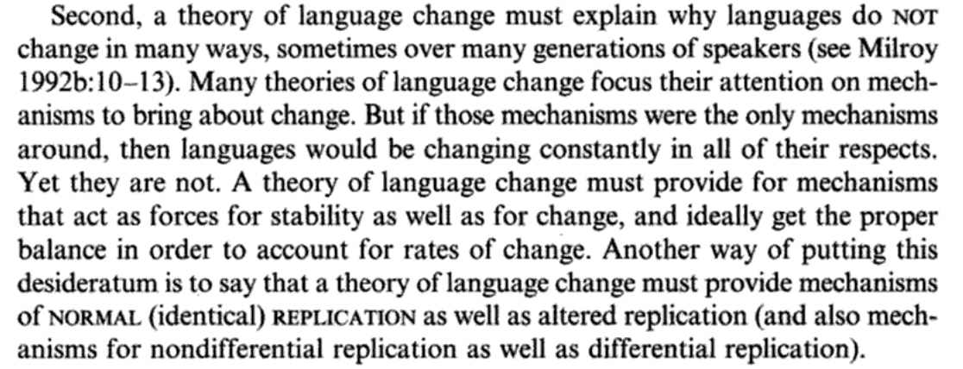
Findings
Experimental diachronics
Understanding why words change
Croft (2000, p.4)
Notes:
Evolution of cognition – leads to learning biases Learning biases shape culture

Slide 32
Findings
Experimental diachronics
Understanding why words change
mum
μαμά
mama
maman
mamá
butterfly
Πεταλούδα
schmetterling
papillon
mariposa
Notes:
Evolution of cognition – leads to learning biases Learning biases shape culture

Slide 33
Findings
Experimental diachronics
Understanding why words change
Ic ne secge
(Beowolf, 900)
Ic ne sege noht
(Ormulum, 1100)
I seye not
(Chaucer, 1400)
I doe not say
(Shakespeare, 1600)
I don’t say
(Woolf, 1900)
Dukelow (2017), Newberry (2017)
Notes:
Evolution of cognition – leads to learning biases Learning biases shape culture

Slide 34
Findings
Experimental diachronics
Understanding why words change
Notes:
Evolution of cognition – leads to learning biases Learning biases shape culture

Slide 35
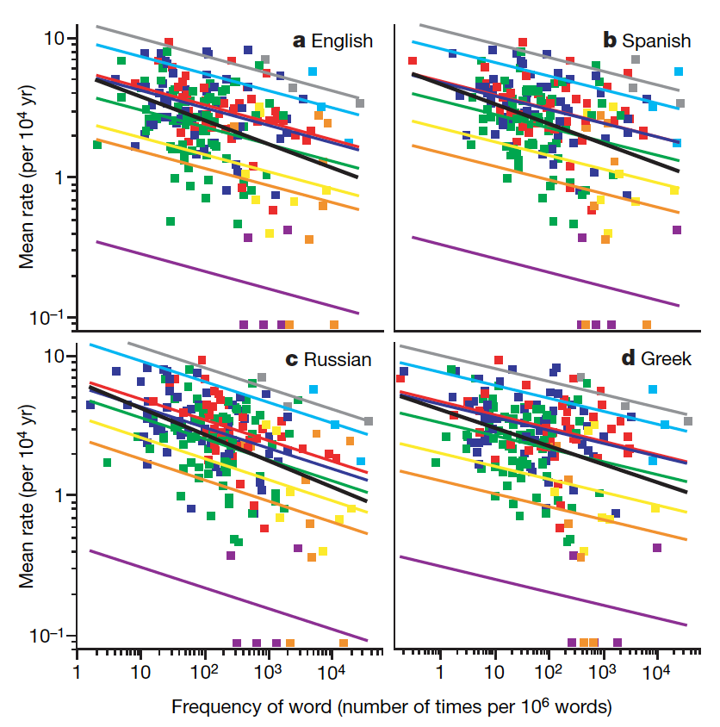
Findings
Experimental diachronics
Understanding why words change
Pagel, Atkinson & Meade (2007)
Notes:
Evolution of cognition – leads to learning biases Learning biases shape culture

Slide 36
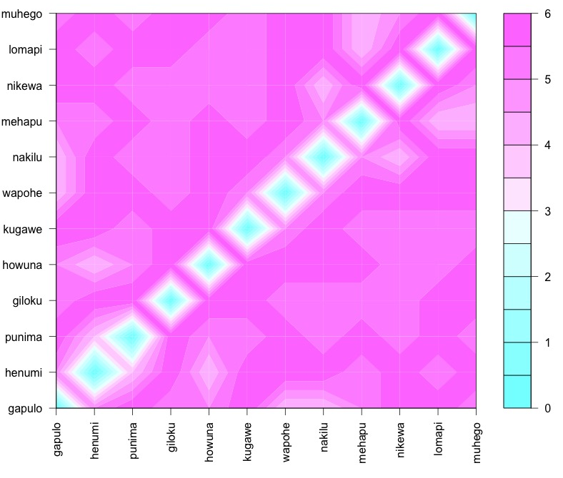
Findings
Experimental diachronics
Understanding why words change
Notes:
Evolution of cognition – leads to learning biases Learning biases shape culture

Slide 37
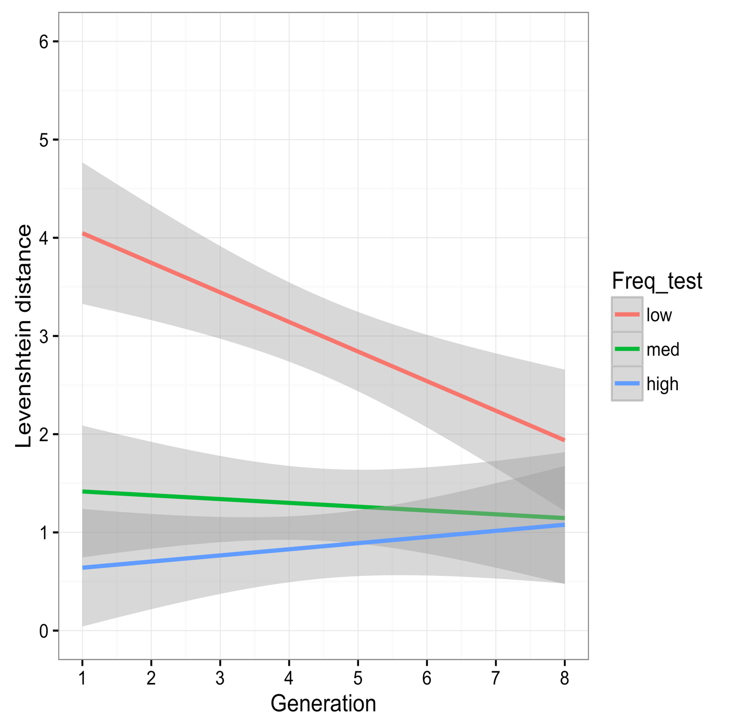
Findings
Experimental diachronics
Understanding why words change
Frequency | Generation 1 | Generation 7
low | giloku | mihewu
low | howuna | mihuge
low | kugawe | napiwa
low | lomapi | nokiwa
med | nakilu | lilipe
med | wapohe | lamupo
med | muhego | hewino
med | punima | wopehu
high | henumi | punima
high | gakulo | logopi
high | nipewa | henumi
high | mehapu | gakulo
Brand & Monaghan (in prep)
Notes:
Evolution of cognition – leads to learning biases Learning biases shape culture

Slide 38
Findings
Experimental diachronics
Understanding why words change
Word length
Semantics
Age of acquisition
Grammatical categories
Notes:
Evolution of cognition – leads to learning biases Learning biases shape culture

Slide 39
Findings
Experimental diachronics
Conclusions
What you have learnt today:
What language evolution is
Why we study it
How to study it
What studying it has shown us
Why multi-disciplinary research is important
Notes:
Evolution of cognition – leads to learning biases Learning biases shape culture

Slide 40
Questions/ ?
j.brand@lancaster.ac.uk
Notes:
Evolution of cognition – leads to learning biases Learning biases shape culture

Slide 41
Further reading
Croft, W. (2000). Explaining language change: An evolutionary approach. Pearson Education.
Christiansen, M. H., & Kirby, S. (Eds.). (2003). Language evolution. OUP Oxford.
Christiansen, M. H., & Chater, N. (2008). Language as shaped by the brain. Behavioral and brain sciences, 31(5), 489-509.
Darwin, C. (1888). The descent of man and selection in relation to sex (Vol. 1). Murray.
Fehér, O., Ljubičić, I., Suzuki, K., Okanoya, K., & Tchernichovski, O. (2017). Statistical learning in songbirds: from self-tutoring to song culture. Phil. Trans. R. Soc. B, 372(1711), 20160053.
Kirby, S., Tamariz, M., Cornish, H., & Smith, K. (2015). Compression and communication in the cultural evolution of linguistic structure. Cognition, 141, 87-102.
Pagel, M., Atkinson, Q. D., & Meade, A. (2007). Frequency of word-use predicts rates of lexical evolution throughout Indo-European history. Nature, 449(7163), 717.
Notes:
Evolution of cognition – leads to learning biases Learning biases shape culture

